Slide 1


Using NLP With Python to Predict Diseases
Presented By-
Team Healthcare
-Aman Kumar Shrivastava
-Ambuj Kulshreshtha

Slide 2
Contents
Overview of Project
Building the NLP Model
Snapshot of project
Conclusion

Slide 3
Overview of Project
The doctor-patient speech interaction is passed to our NLP model, based on the drug reviews dataset,to classify the text into a medical condition.Based on the diagnosis by the tool,a recommendation for medication is also provided,again based on the dataset.

Slide 4
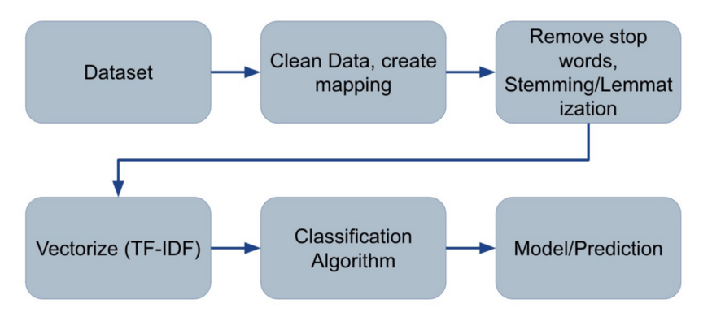
Building the NLP Model

Slide 5
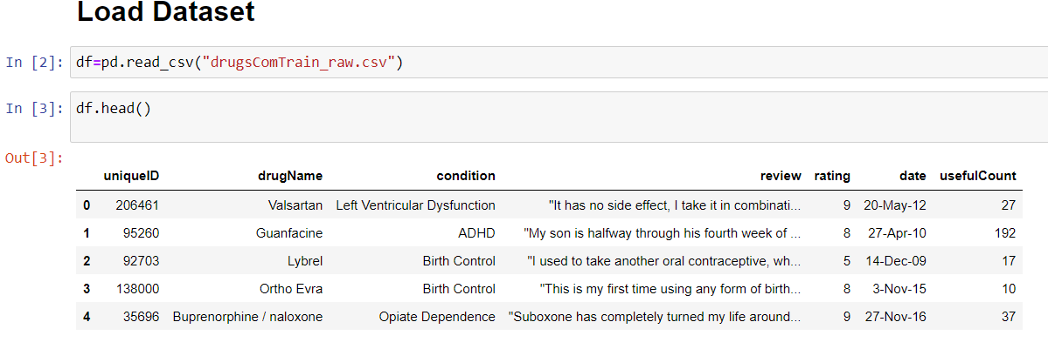
Datasets
Input variables=review
Target variables=
Drugname
Rating
UsefulCount

Slide 6
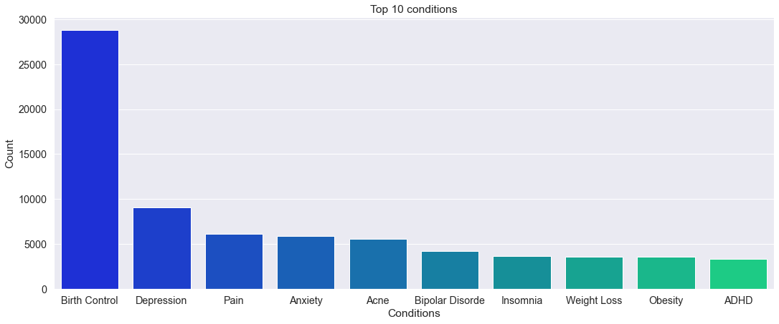
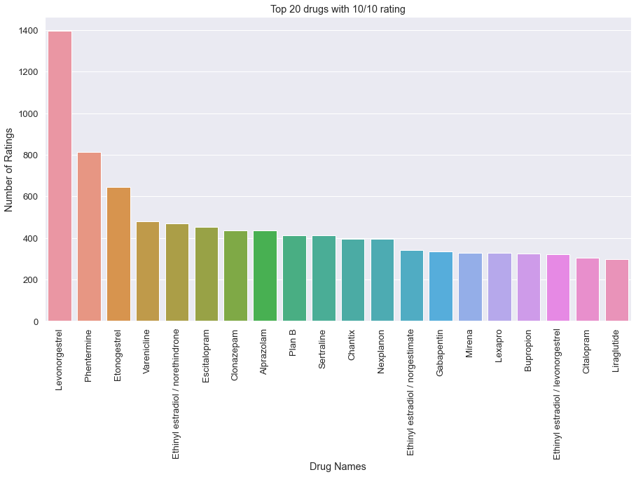
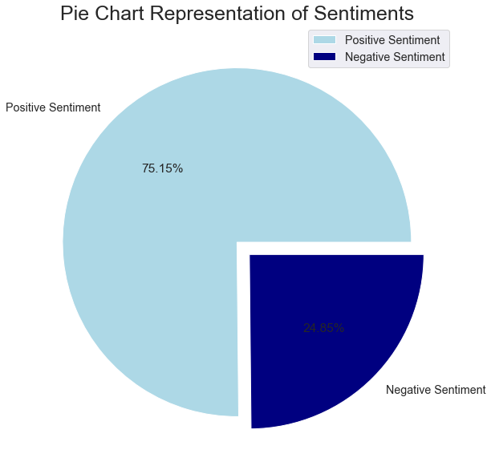
Data Visualisation

Slide 7
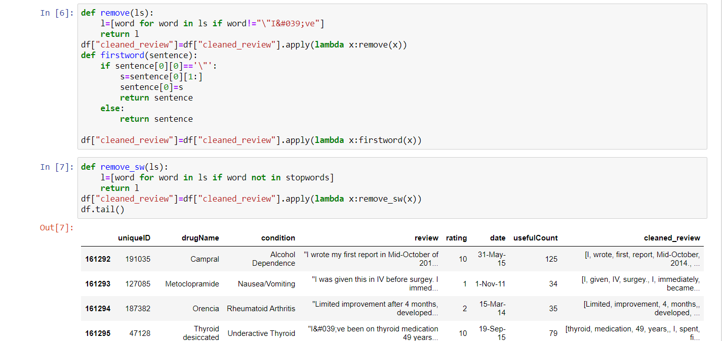
Removing stopwords

Slide 8
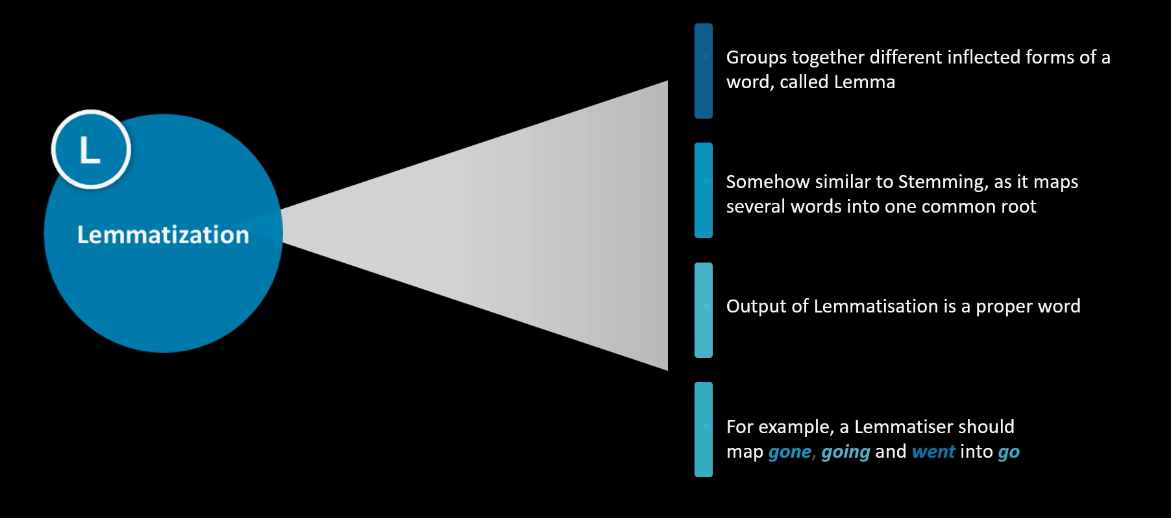

Slide 9
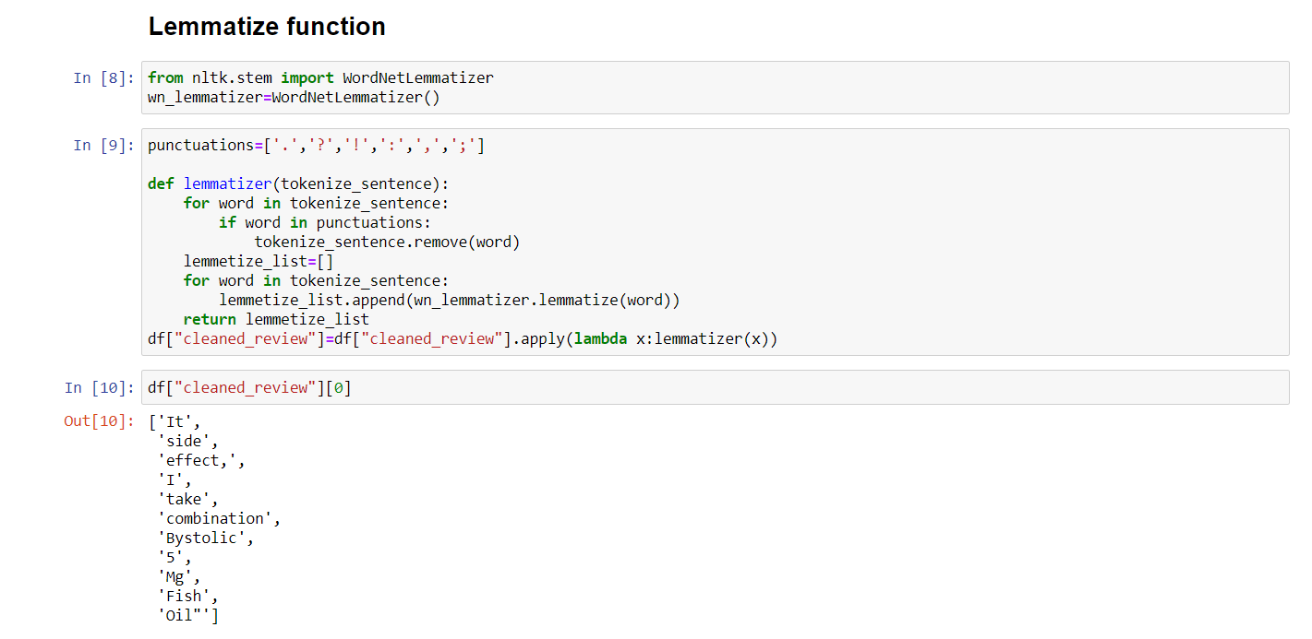

Slide 10
Vectorization
Since classification models have to work on numbers and not words, we need to convert the text to numbers in some way. This is called vectorizing. A popular approach to vectorizing text in Natural Language Processing is to use the TF-IDF vectorizer.
The TF-IDF vectorizer stands for Term-Frequency-Inverse-Document-Frequency.

Slide 11
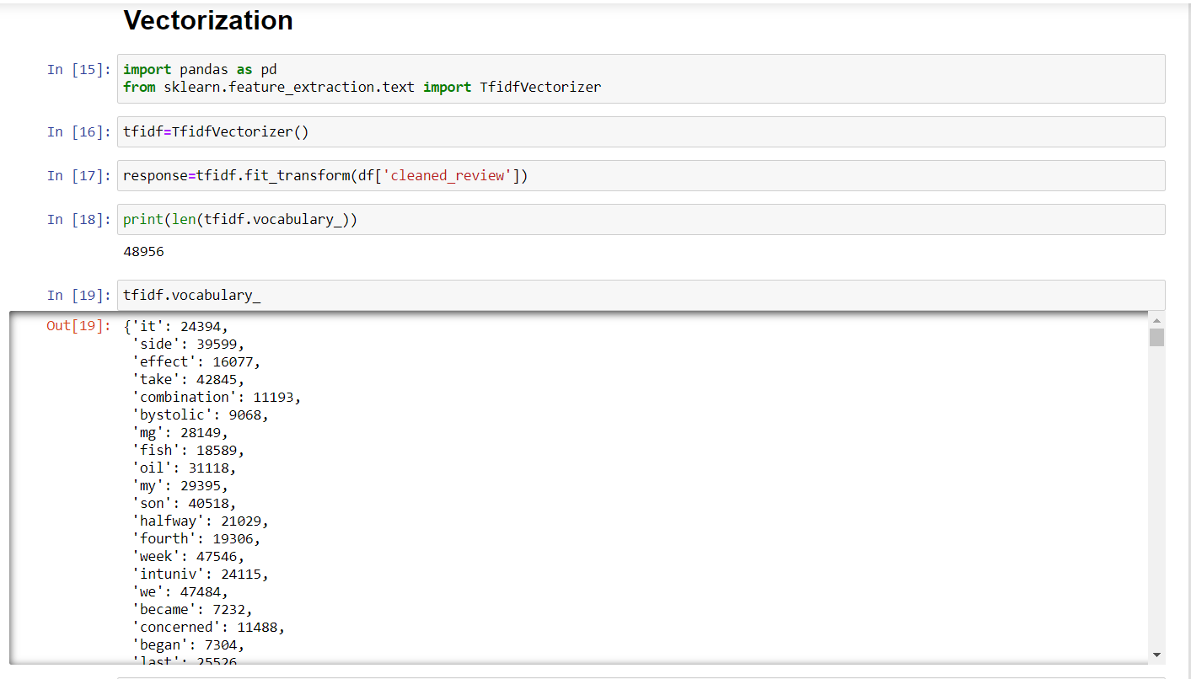

Slide 12
Classification Algorithm
With the vectorization complete, we can run commonly used classification models on the vector.
Stochastic Gradient Descent gave us the best results. While the accuracy wasn’t high, the precision and recall seemed fairly balanced across the categories.

Slide 13
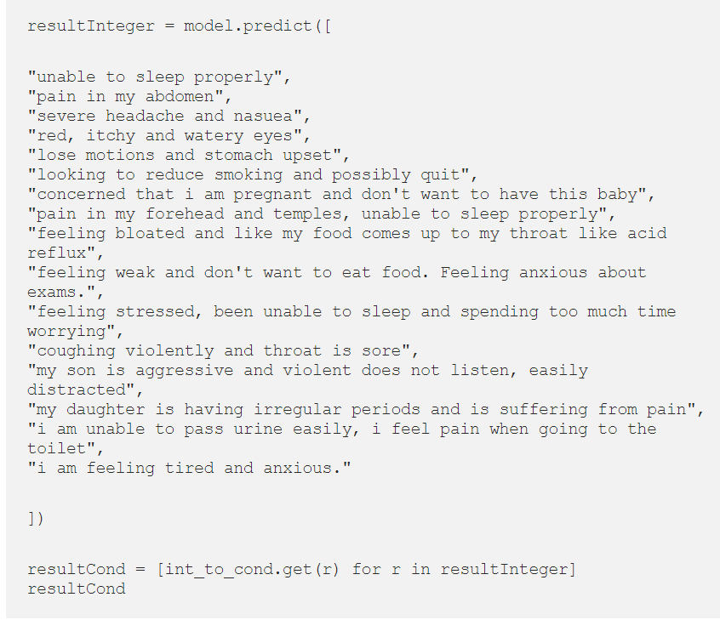
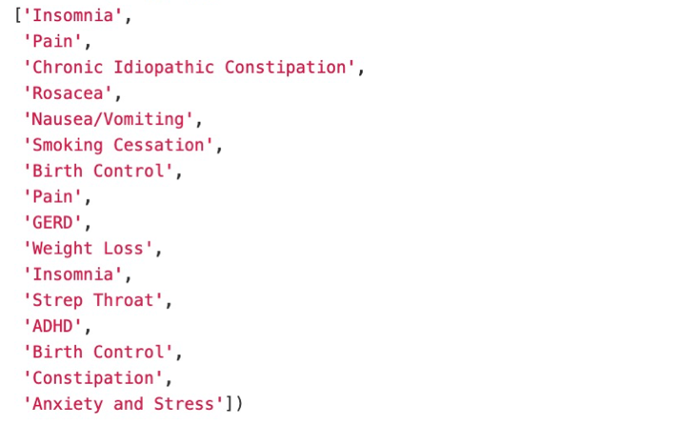
Final Output

Slide 14
Conclusion
Our idea is not to replace a doctor/medical practitioner. In fact, the idea is to assist/enable a medical practitioner in their work.
In addition to better medical prescriptions, the tool provides a smarter inventory for pharmacies. Pharmacists can know what most commonly occurring conditions are for a particular region and stock up accordingly.

Slide 15

This Photo by Unknown Author is licensed under CC BY-SA-NC

